Slide 1
DESIGNING A UNIFIED THREAT MANAGEMENT SYSTEM FOR HOME NETWORKS
Guided by
Dr. M. Blessy Queen Mary M.E, PH.D.
Team Members
Aswin S - 71772218102
Janardhan M - 71772218116
Praghadeesh S - 71772218138
Iyappan K - 71772218L04

Slide 2
OBJECTIVES
To design a Smart Unified Threat Management System (SUTMS) for home networks.
Provide corporate-grade security to personal/home devices like laptops, mobiles, and IoT gadgets.
Develop a lightweight, cost-effective, and easy-to-deploy solution using Raspberry Pi.
Ensure multi-layered protection – Flow detection, Intrusion detection, Firewall, Anti-bot protection.
Reduce CPU/memory usage while maintaining high detection accuracy (≈99%).

Slide 3
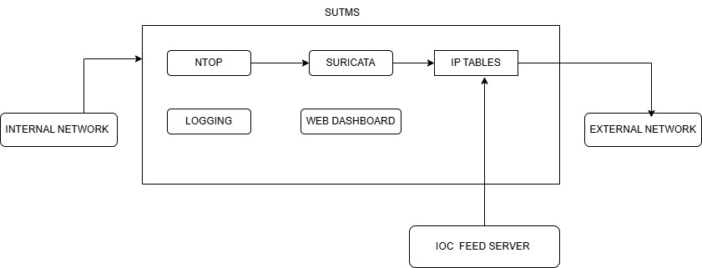
SYSTEM ARCHITECTURE
DEPLOYMENT STRATEGY :
Inline with Existing Router — Lives between internal network and external network

Slide 4
INNOVATION & TECHNOLOGIES
INTEGRATION OF NTOP AND SURICATA:
NTOPng
  Monitors real-time network traffic and active connections.
  Detects flow patterns, bandwidth usage, and anomalies.
Suricata
  Performs deep packet inspection to detect intrusions and attacks.
  Uses IDS/IPS rules to alert or block malicious packets.
Integration of NTOPng and Suricata
  NTOPng collects flow data from all connected devices.
  Flow details are shared with Suricata for focused packet inspection.
  Suricata analyzes only suspicious or abnormal flows for threats.
  Together, they provide accurate, fast, and real-time network protection.

Slide 5
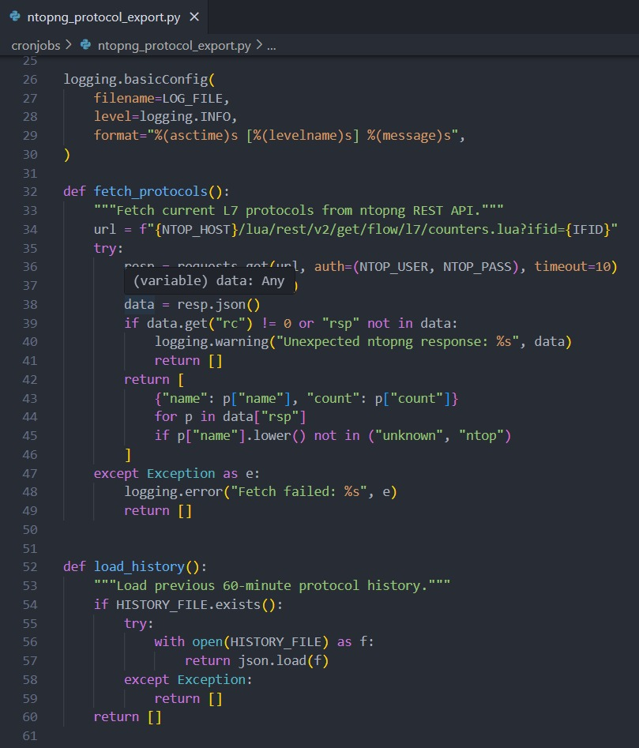
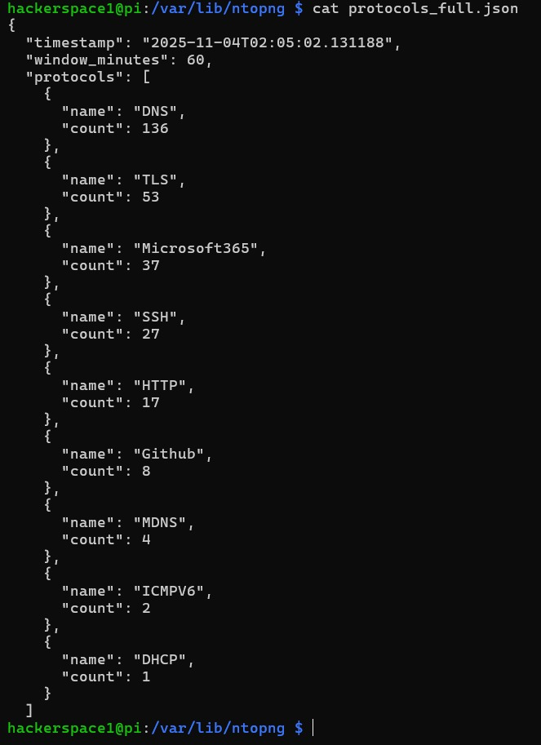
INNOVATION & TECHNOLOGIES
NTOPng Integration

Slide 6
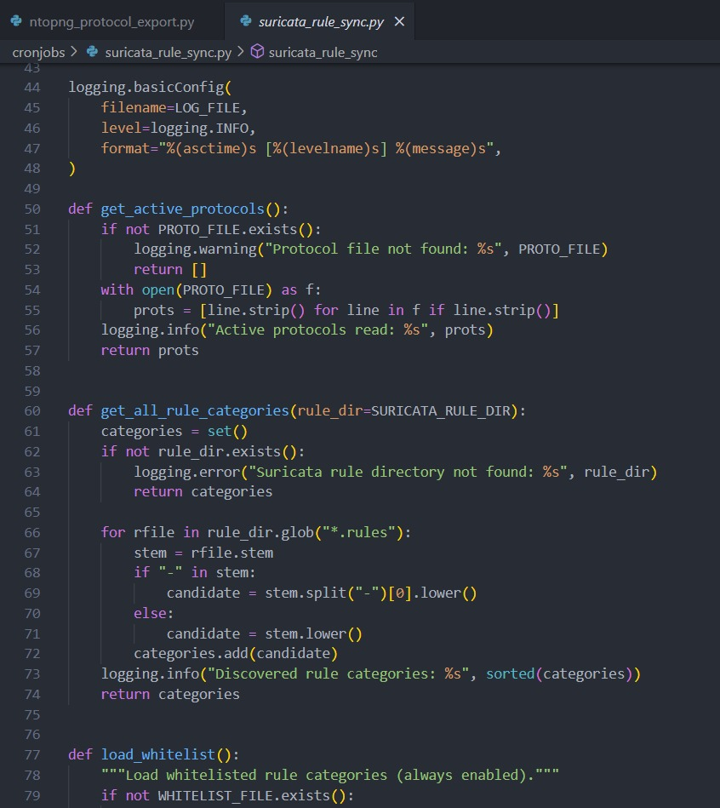
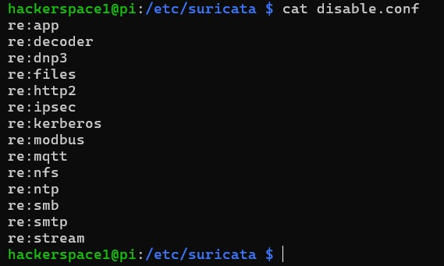
INNOVATION & TECHNOLOGIES
Suricata Integration

Slide 7
INNOVATION & TECHNOLOGIES
Custom IoC Feed Server:
  Aggregates IoCs from multiple open threat servers (STIX/TAXII, OTX, Anomali, etc.).
  Performs data normalization, filtering, and duplication removal before deployment.
  Supplies optimized IoC lists to the firewall for real-time dynamic blocking.
  Maintains local caching → works even when external feeds are offline.
  Extended Opportunities:
    Adds Scope to verify and validate IoC signatures
    Enables customization of threat feeds specific to organizational

Slide 8
INNOVATION & TECHNOLOGIES
Web Dashboard
Built for administrative control and monitoring of SUTMS.
Core Functions:
    Update or modify custom firewall rules dynamically.
    Option to pause SUTMS blocking (for work-from-home flexibility).
    Resource Monitoring: Tracks CPU, RAM, and disk usage in real time.
    Network Status Dashboard: Displays traffic flow, bandwidth, and device activity.
    Extends to integrate NTOPng and Suricata web interfaces for deeper analytics.

Slide 9
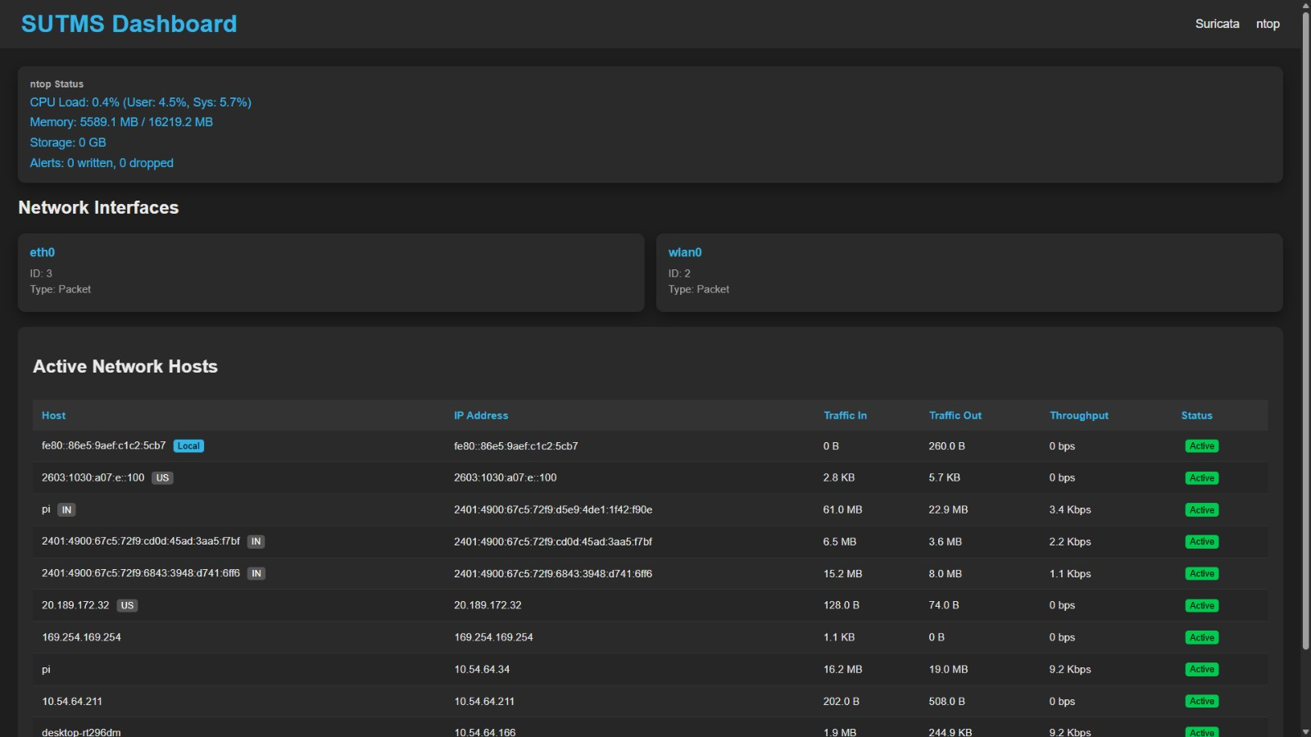
PROJECT OUTCOME

Slide 10
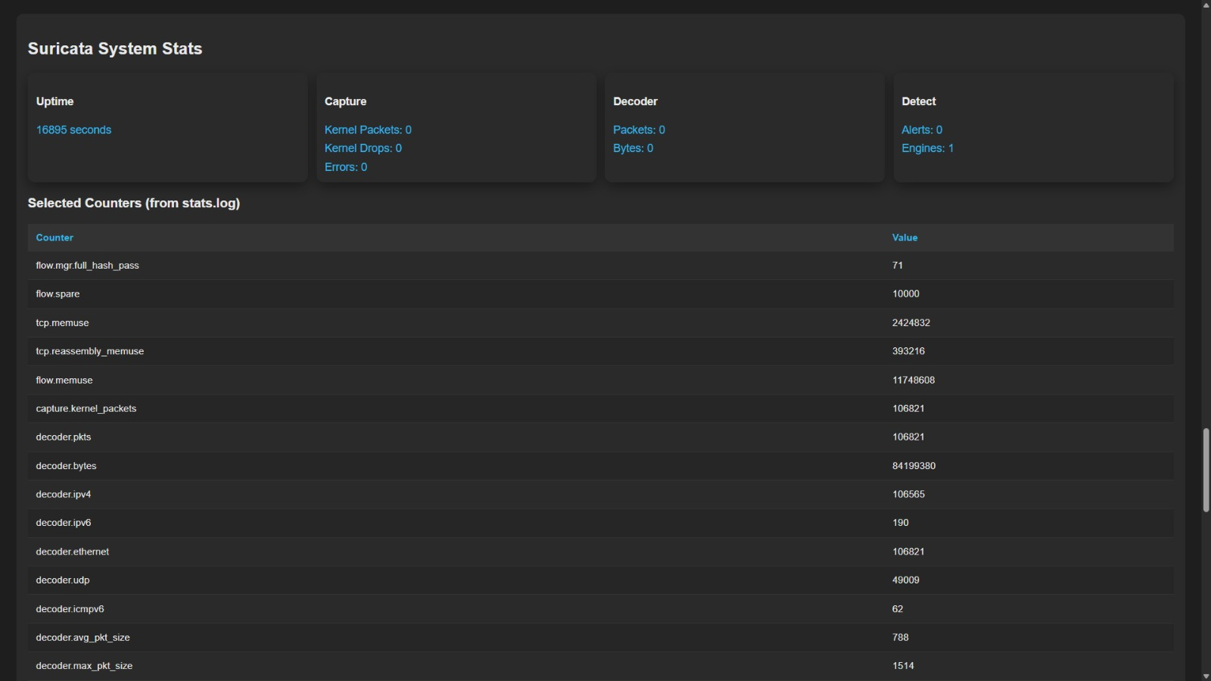
PROJECT OUTCOME

Slide 11
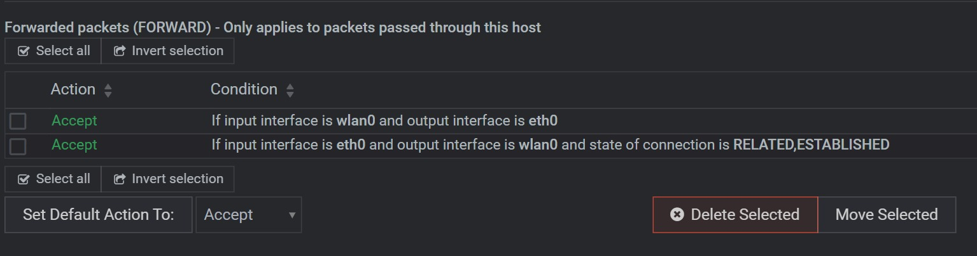
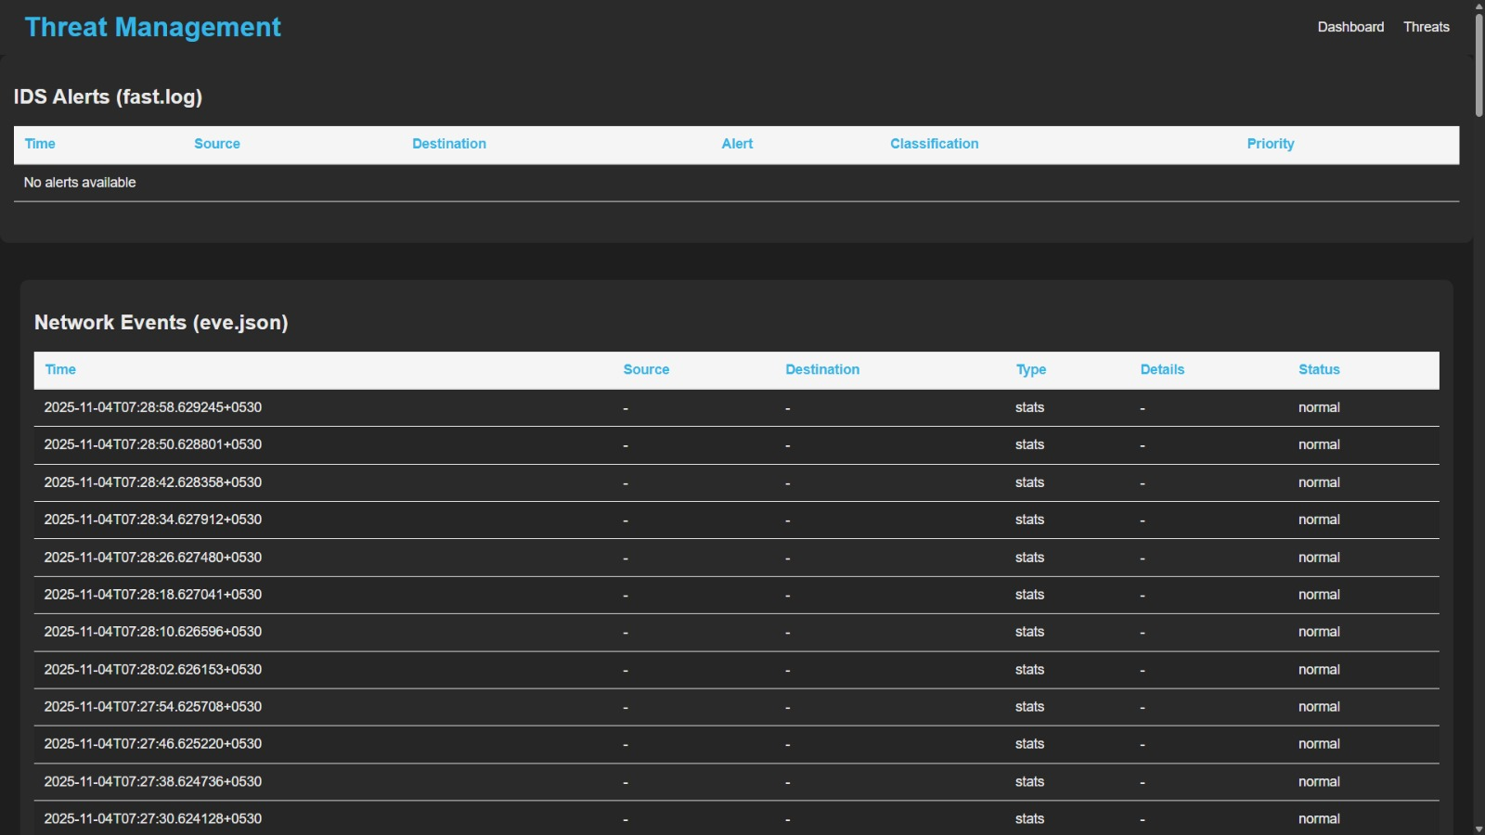
PROJECT OUTCOME

Slide 12
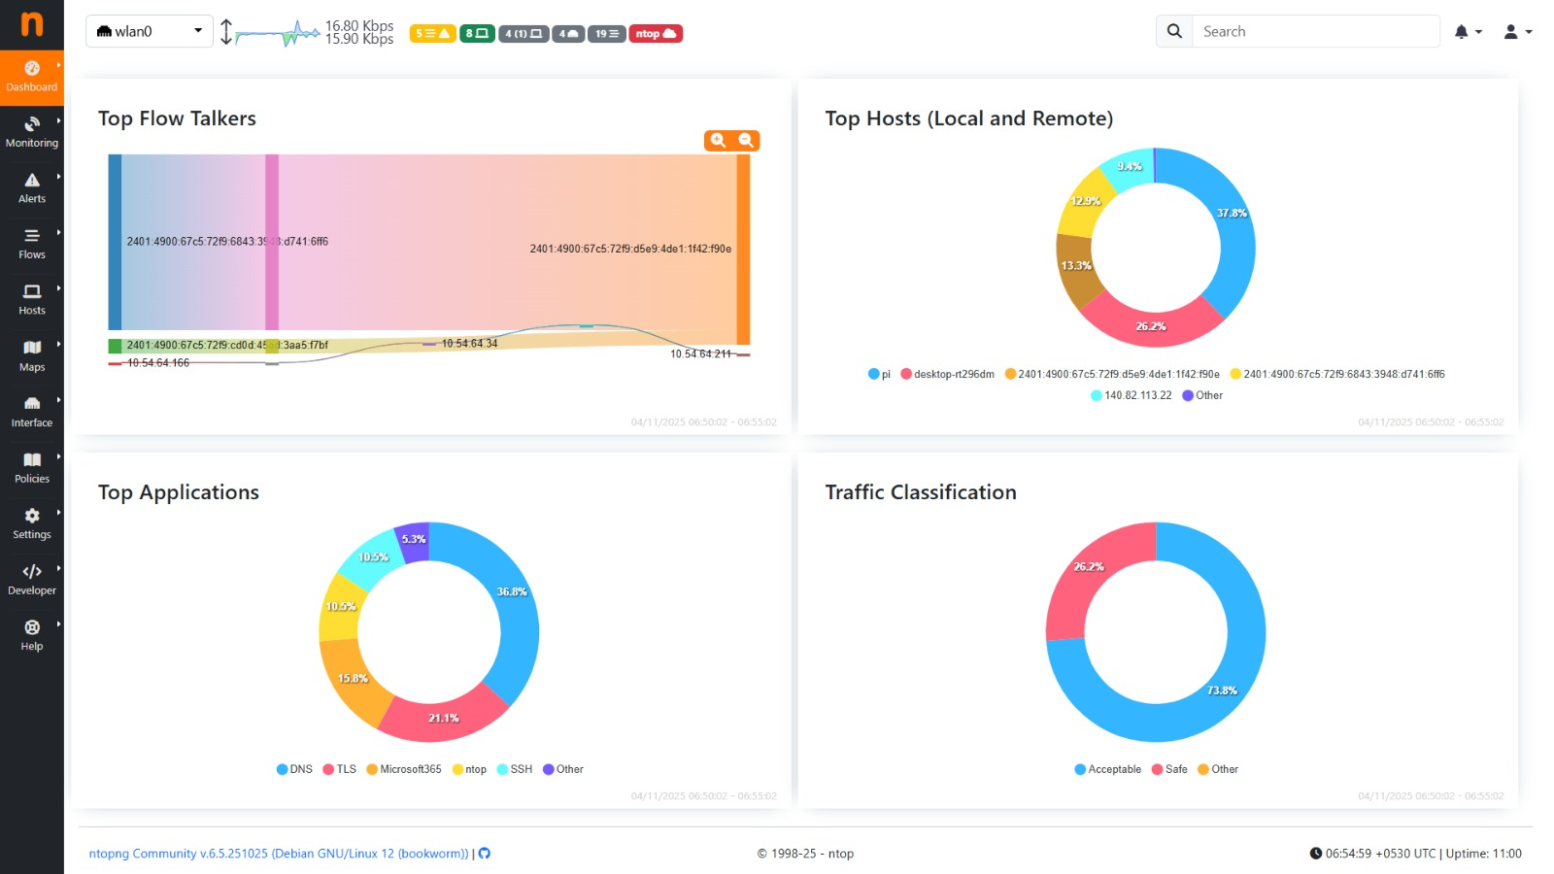
PROJECT OUTCOME

Slide 13
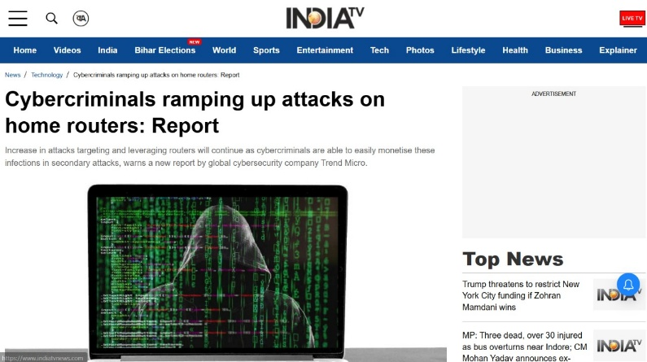
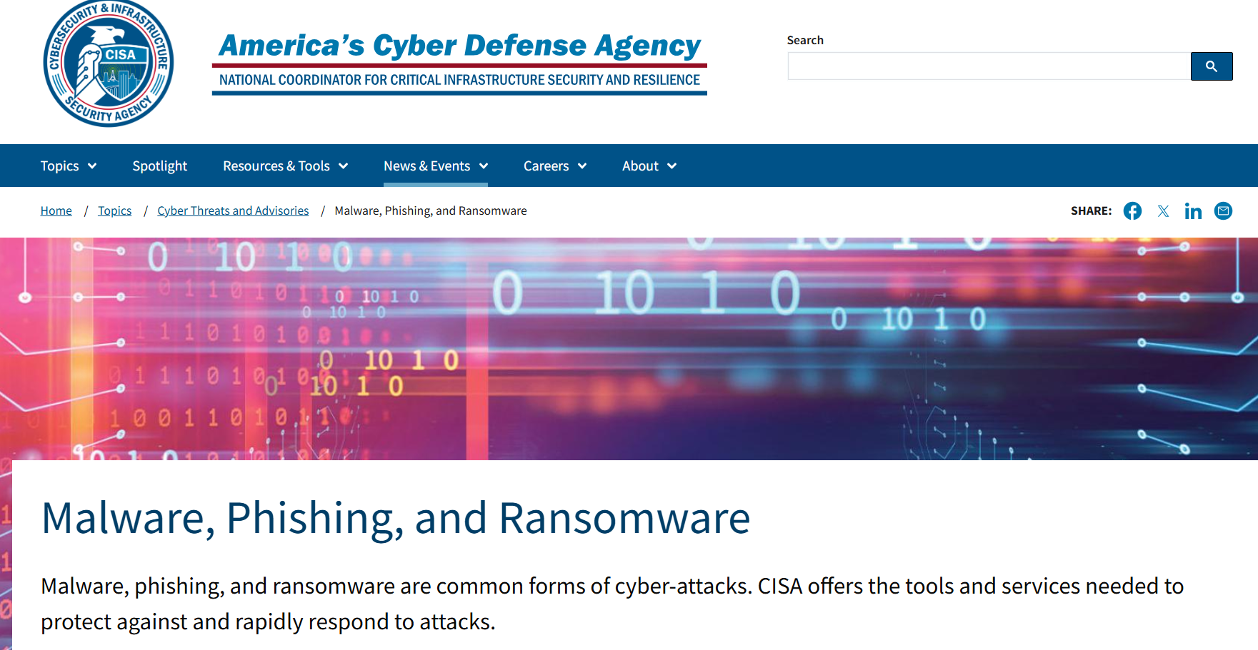
SOCIAL IMPACT & SUSTAINABLITY
Current Home Networks Threads :
Outcomes :
  Protects employees working remotely with secure home network connections.
  Builds corporate confidence in remote and hybrid work environments.
  Non-technical users protect their home network easily..

Slide 14
CHALLENGES
Resource Limitation: Running multiple VMs on one machine reduced performance → moved to cloud.
Hardware Compatibility: Issues across different Raspberry Pi versions.
Software Limitation: Docker on other operating systems made setup and integration difficult.

Slide 15
FUTURE ENHANCEMENTS
1. SSL/TLS Inspection:
Improve handling of encrypted traffic by enabling secure and efficient packet decryption for malware hidden within SSL/TLS layers.
2. Threat Feed Validation:
Develop verified and AI/blockchain-powered systems to validate Indicators of Compromise (IoCs) from multiple sources, ensuring accuracy and reducing false positives.
3. IDS Optimization:
Create smarter, open-source detection engines with data-mining algorithms (like Apriori) to reduce false alerts, adapt to new applications, and defend against zero-day threats.

Slide 16
THANK YOU

